Slide 1
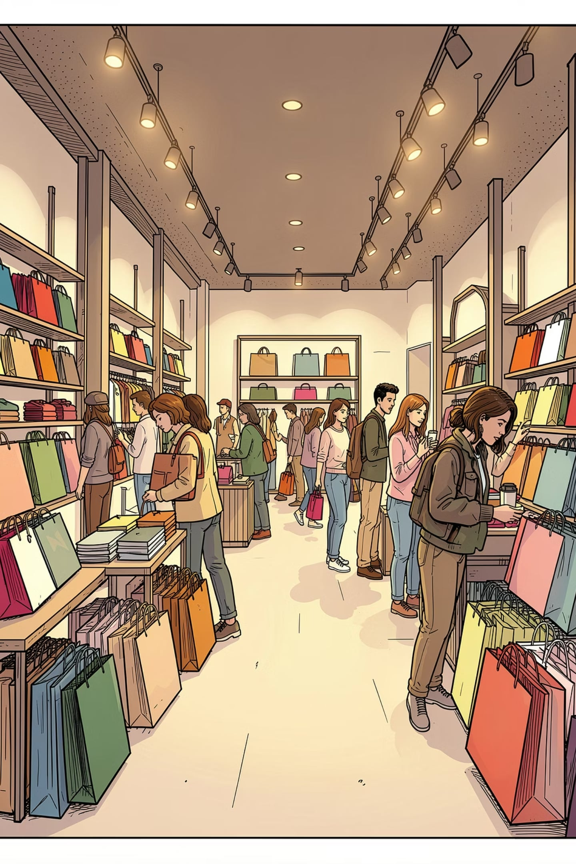
Customer Shopping Behavior Analysis
Uncovering spending patterns, customer segments, and product preferences across 3,900 transactions

Slide 2

Dataset at a Glance
3,900
18
Purchases
Columns
37
Missing Values
Review Rating only
Demographics, purchase details, and shopping behavior — loaded into PostgreSQL for analysis.

Slide 3
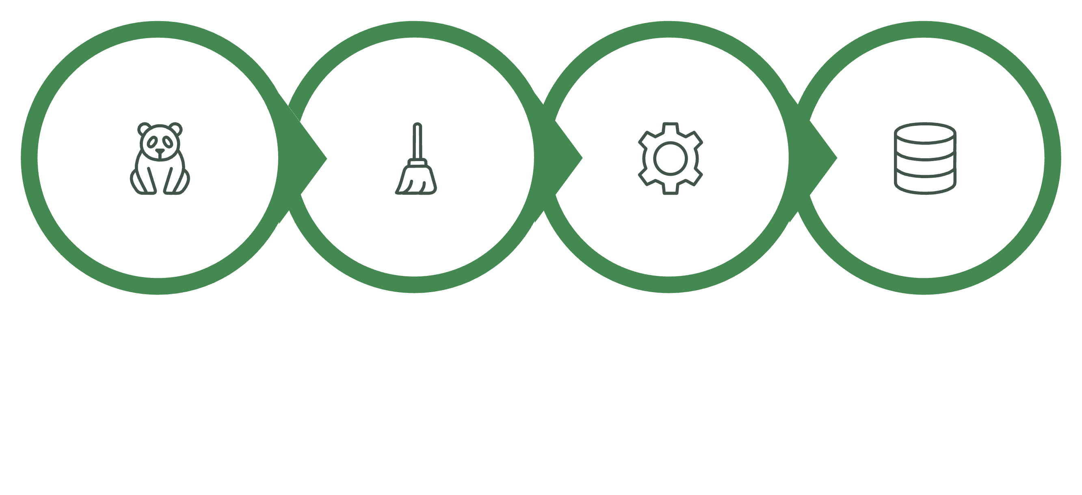
Data Preparation in Python
Load & Explore
Clean & Impute
Engineer Features
Load to PostgreSQL
Columns standardized to snake_case; redundant promo_code_used dropped. Clean data loaded to PostgreSQL.

Slide 4
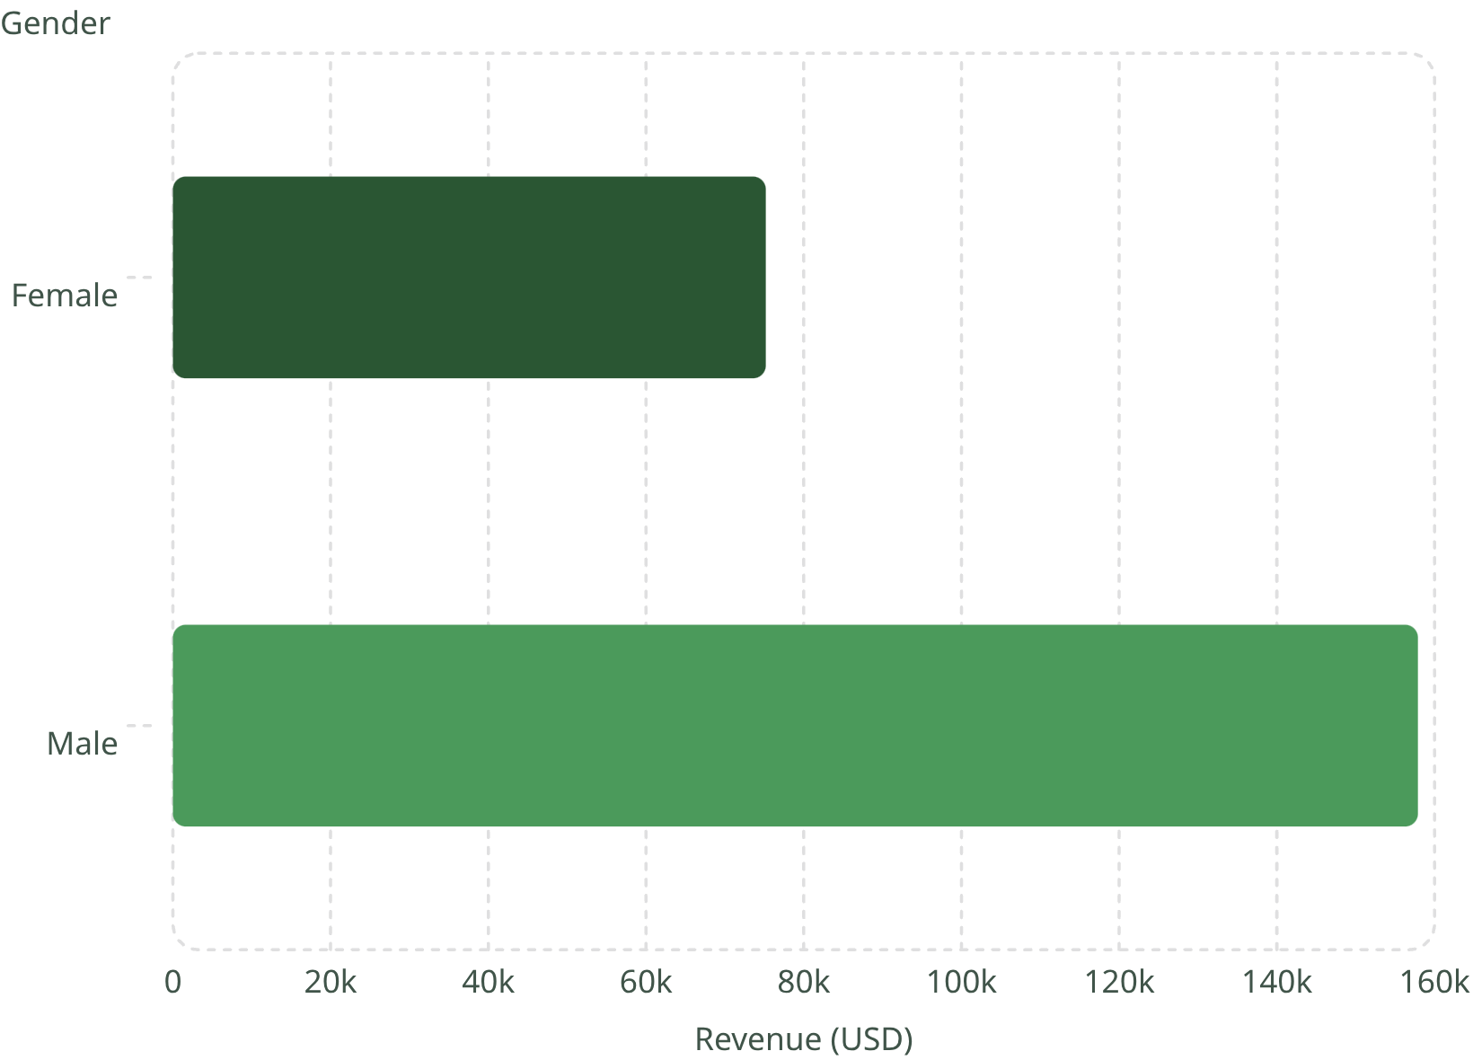

Revenue by Gender
Male customers drive 2× revenue
Male: $157,890
Female: $75,191
Key segment for targeted campaigns.

Slide 5
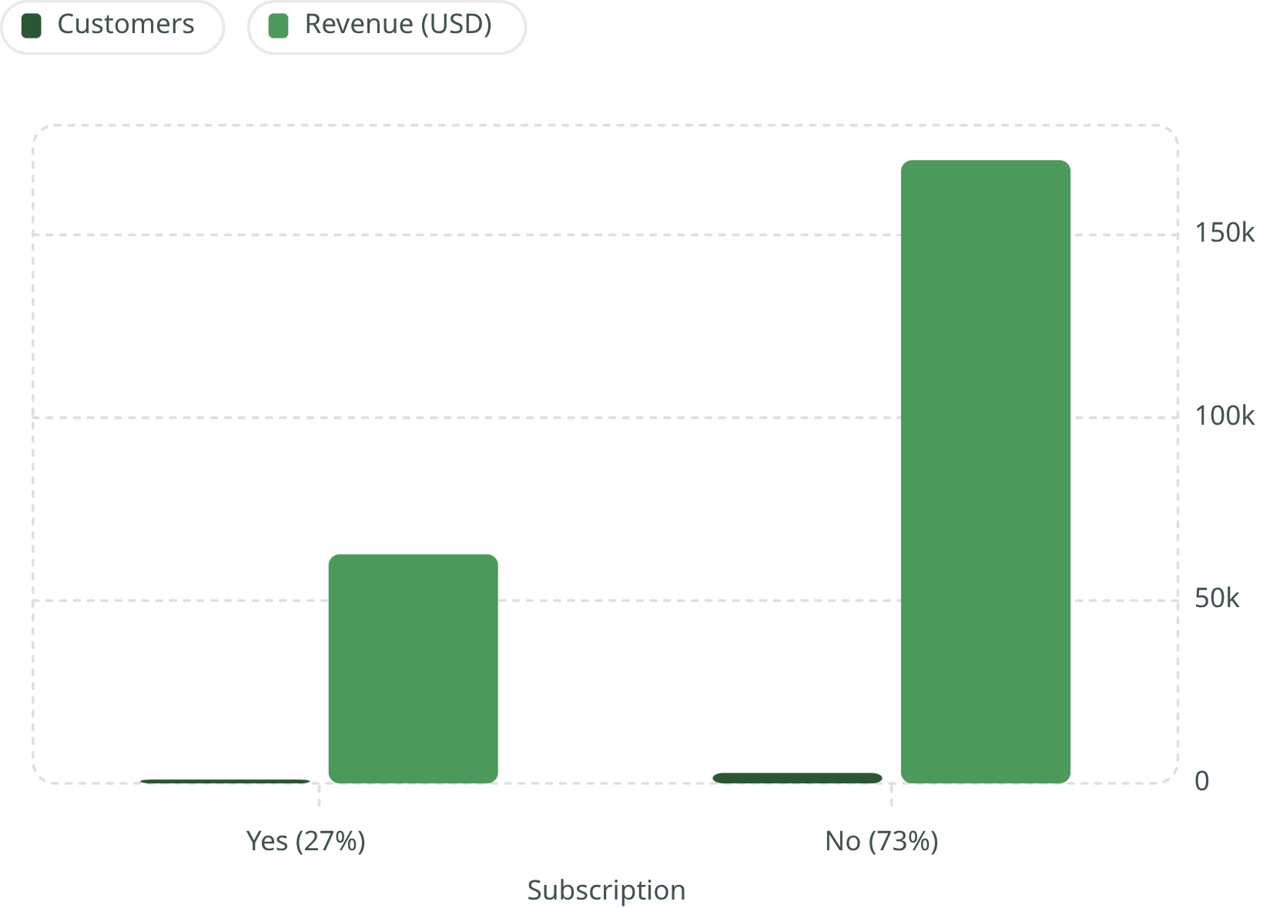
Subscribers vs. Non-Subscribers
73% non-subscribers
Non-subscribers generate $170K vs. $63K from subscribers.
Avg spend nearly identical (~$59).

Slide 6
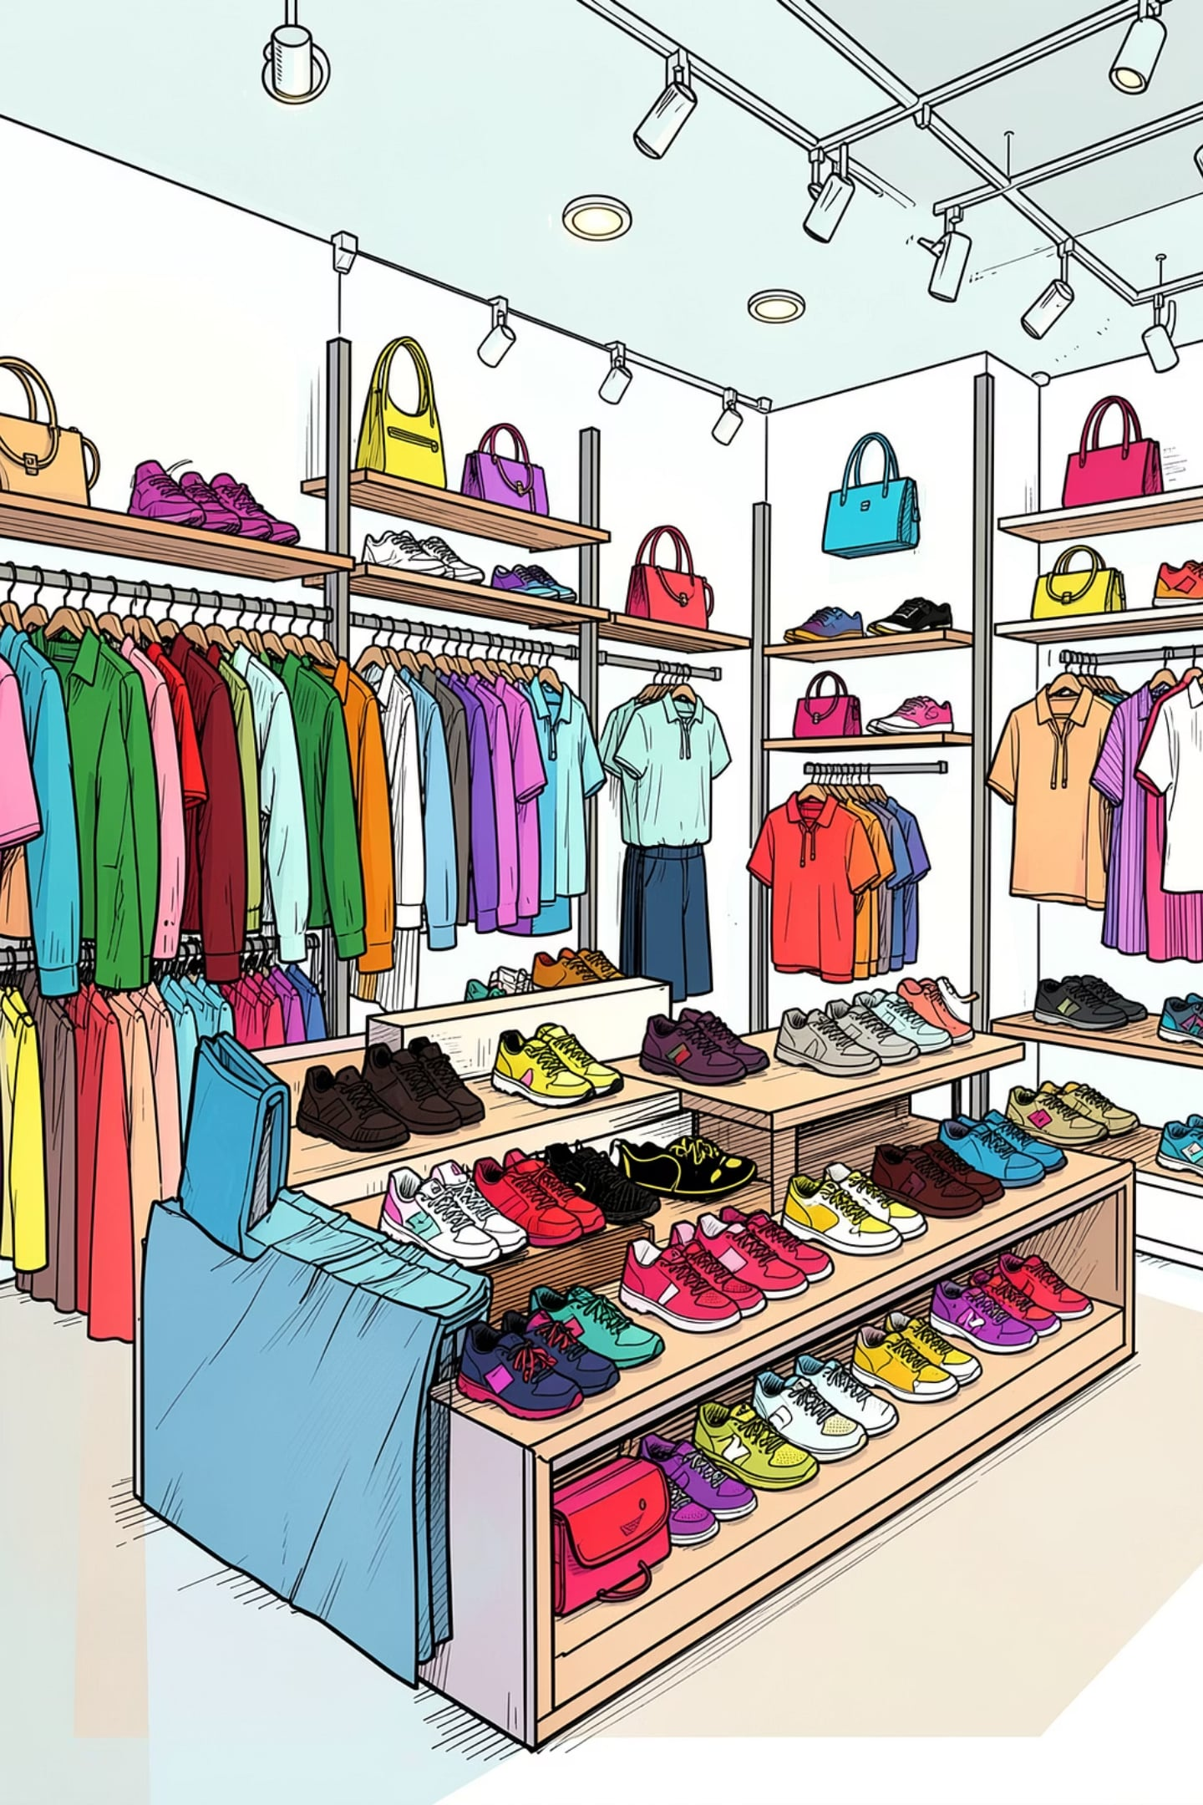
Top Products by Category
Accessories
Jewelry · Sunglasses · Belt
Clothing
Blouse · Pants · Shirt
Footwear
Sandals · Shoes · Sneakers
Outerwear
Jacket · Coat

Slide 7

Ratings, Discounts & Shipping
Top Rated Products
Most Discounted
Gloves — 3.86★
Hat — 50%
Sandals — 3.84★
Sneakers — 49.7%
Boots — 3.82★
Coat — 49.1%
Express avg: $60.48 vs Standard $58.46

Slide 8
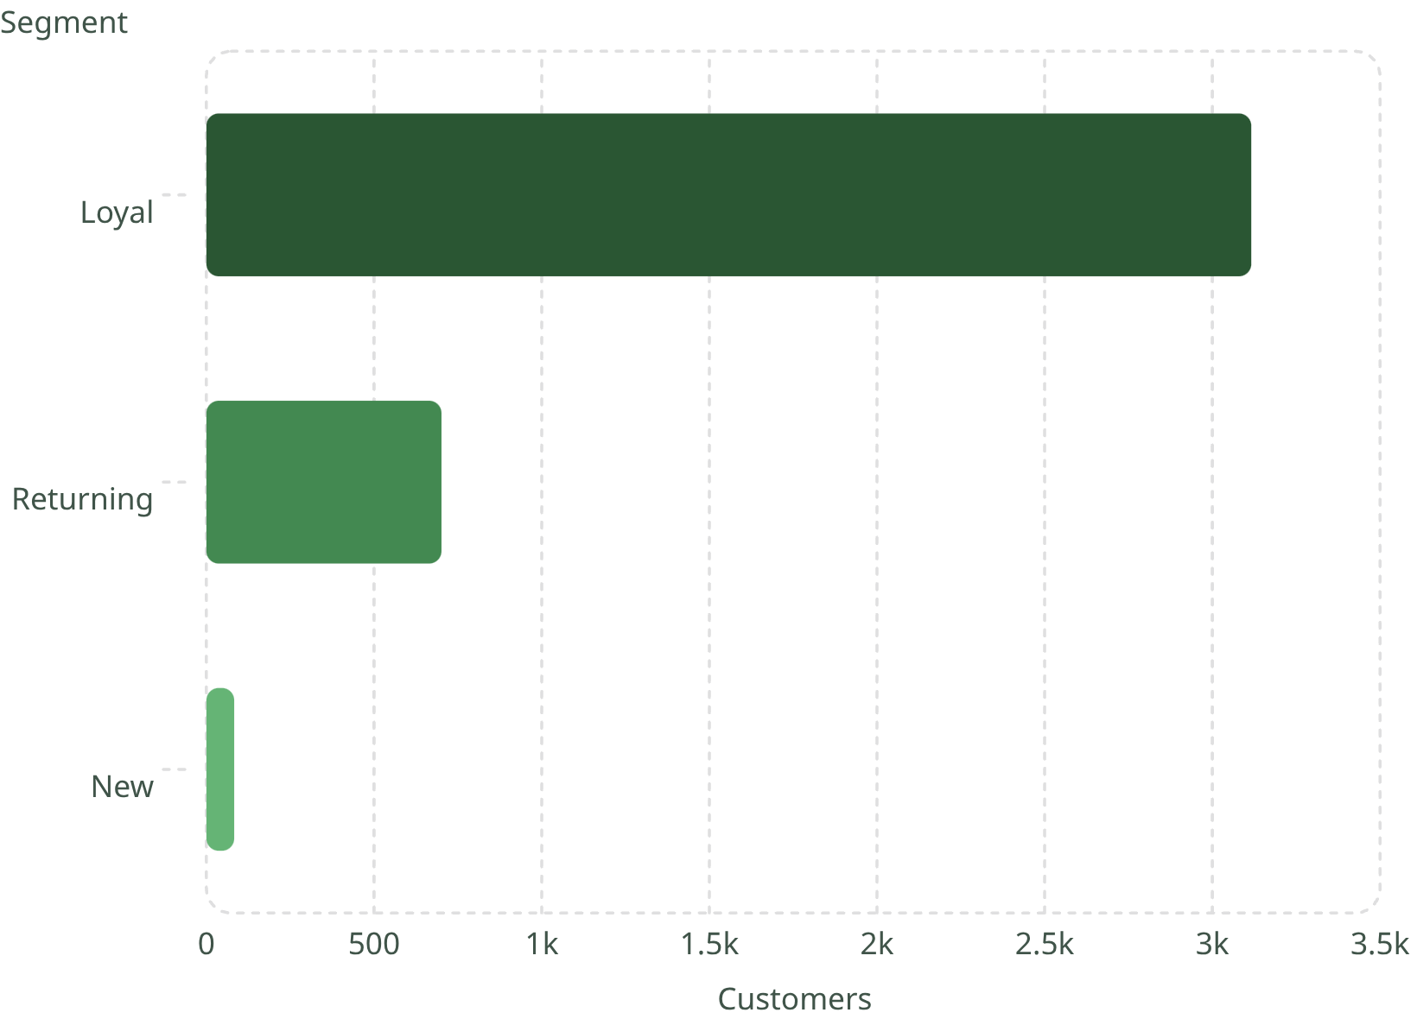
Customer Segmentation
Loyal customers dominate
3,116 loyal buyers (80% of base). Only 83 new customers.
Of 958 repeat buyers (>5 purchases), most remain non-subscribers (2,518).

Slide 9
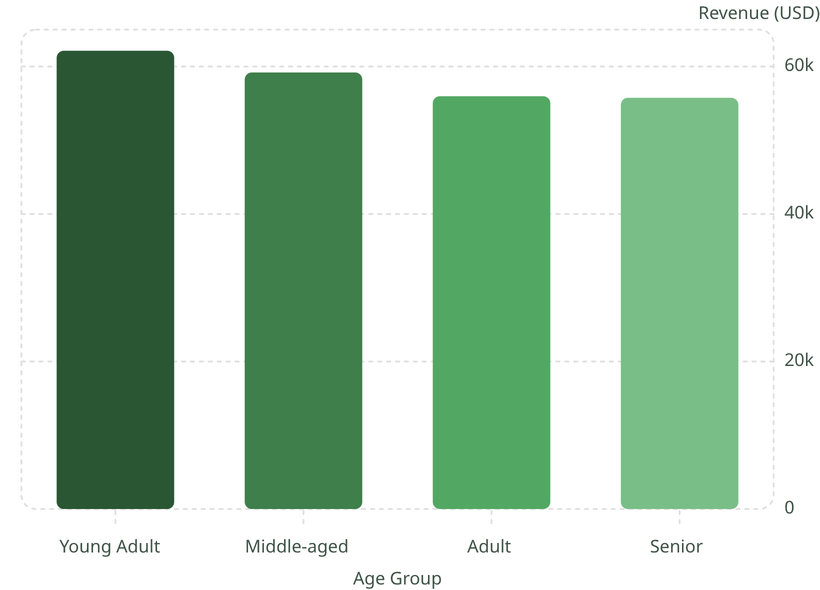
Revenue by Age Group
Young Adults lead revenue
Young Adults: $62K — highest across all age groups.
Revenue narrows with age, but all groups contribute meaningfully.

Slide 10





Business Recommendations
Boost Subscriptions
Promote exclusive subscriber benefits.
Loyalty Programs
Reward repeat buyers toward "Loyal" segment.
Review Discounts
Balance sales lift with margin control.
Targeted Marketing
Focus on high-revenue age groups and express-shipping users.

